Slide 1
Updates for C63
ISED – C63 presentation – October 2026

Slide 2
Agenda
Standards Updates
Recognized Labs and CBs
Report Issues
Major issues

Slide 3
Standards Updates

Slide 4
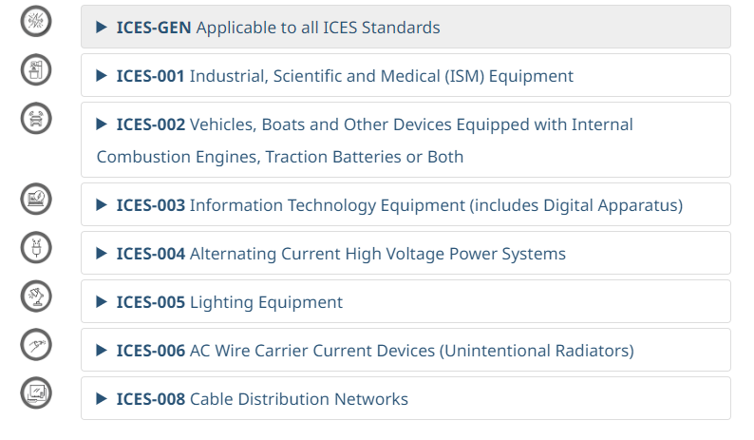
Interference Causing Equipment Standards (Unintentional Radiators)
No updates to share at this time on ICES standards.
4

Slide 5
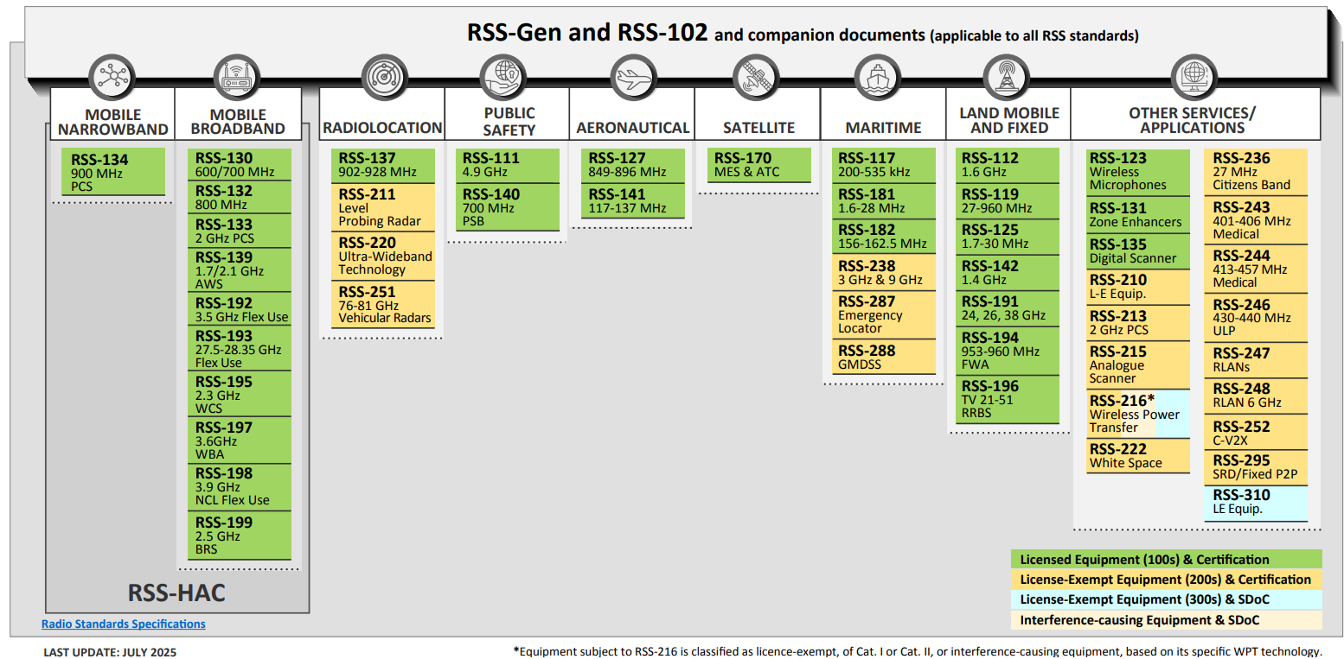

Update on Radio Equipment Standards
Recently updated/Under revision

Slide 6
Adoption of ANSI/USEMC C63.25.2-2024
With the publication of Issue 6 of RSS-Gen — General Requirements for Compliance of Radio Apparatus, ISED has adopted
ANSI/USEMCSC C63.25.2-2024 for site validation below 1GHz.
The Normative Reference Standards webpage has been updated accordingly:
  ANSI/USEMCSC C63.25.2 (site validation methods, 30 MHz to 1 GHz):
    ANSI/USEMCSC C63.25.2-2024

Slide 7
Recognized Labs and CBs

Slide 8
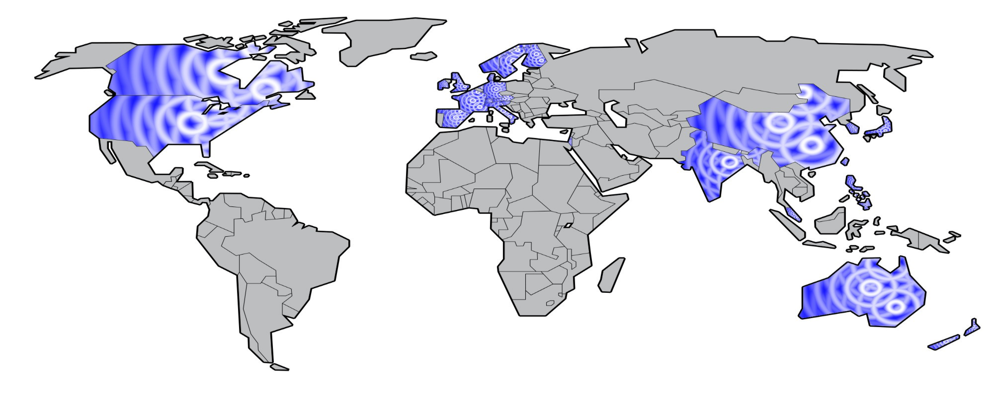
Recognized Wireless Testing Laboratories and Certification Bodies
Sweden
4
Canada
15 / 5
Netherlands
2 / 1
Norway
1
China
170
Korea
33
Denmark
2
Finland
5
UK
7 / 3
Germany
18 / 3
Ireland
1
France
11
Austria
1/ 1
Japan
10
USA
81 / 20
Spain
2 / 2
Switzerland
1
Czech
1
Slovenia
1
Chinese Taipei
30
Israel
6
Hong Kong
7
Italy
8
India
8
Malaysia
3
Singapore
3 / 1
Australia
3
September 3, 2026
Total: 433 Labs
36 CBs
New Zealand
3
8

Slide 9
Amendments to the Testing Laboratory Technical Assessment Checklist
With the publication of Issue 6 of RSS-Gen — General Requirements for Compliance of Radio Apparatus, ISED has amended the checklist for site validation below 1GHz in accordance with ANSI/USEMCSC C63.25.2-2024.
Questions Q2a, Q9 and Q40b of the Testing Laboratory Technical Assessment Checklist have been updated accordingly.
The previous checklist (dated June 25, 2024) may be used until the end of the RSS-Gen, issue 6 transition period on July 30, 2027.

Slide 10
Report Issues

Slide 11
Major recurring deficiencies
Missing measurement results
Measurement methodology
Missing spectral plots
Missing band-edge plots
Missing results above 18 GHz
Missing results through the tenth harmonic
Missing worst-case plots
Insufficient data for supported configurations
Incorrect RBW down-conversion
Incorrect or unclear detector selection
Insufficient sweep time or test points
Wrong test mode or channel
Inadequate test-site setup

Slide 12
Major recurring deficiencies – cont’d
Corrections and Calculations
Equipment Lists
Unexplained offset values
Flat correction factors
PSD results were adjusted using RBW down-conversion
Attenuator and plot-offset inconsistencies
Missing antenna or passive-device corrections
Passive devices excluded from equipment lists
  Missing measurement cables
  Missing attenuators and splitters
Equipment shown in diagrams but not documented

Slide 13
Common Testing Errors
Emissions need to be measured for each mode of operation.
It is not acceptable to have identical results within different technology specific reports.
RSS-131 applicability list
Zone enhancers can only be certified to operate under a standard that is listed on the applicability list.
Zone enhancers that operate outside these standards are out of scope for RSS-131.
AC Powerline Emissions
Level Probe measurements
Testing must be performed using the requirements in ETSI EN 302 729 or EN 302 372, depending on the type of probe.
This includes any special arrangements for the test site.
Proper alignment of the transmit antenna boresight is critical.

Slide 14

Major issues

Slide 15
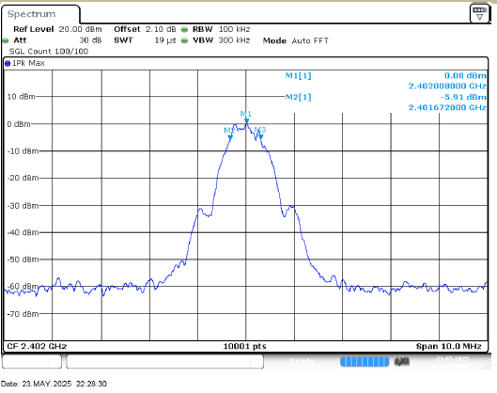
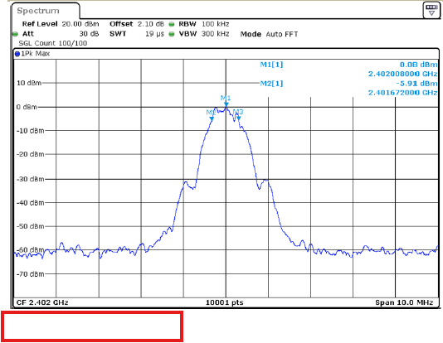
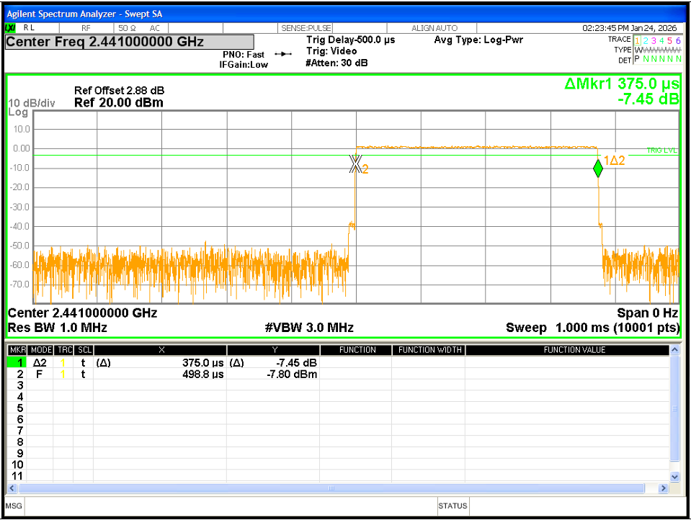
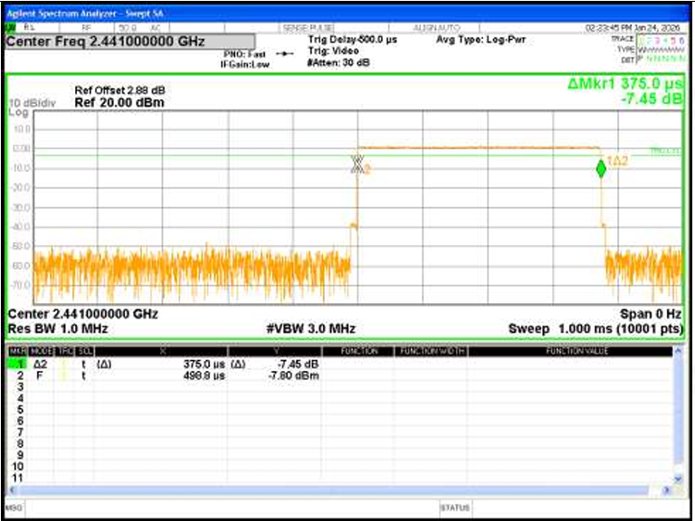
Quality trends in test reports
Data re-use
Data re-use has become an emerging trend
What to watch for
spectrum analyzer plots missing timestamps
fuzzy image resolution
Reporting identical results for different modes (example: AC Powerline in WiFi, BT reports)

Slide 16
Questions?

