Slide 1
FCC Summary
Alfonso G. Tarditi
Laboratory Division
Office of Engineering and Technology
Federal Communications Commission
Note: The views expressed in this presentation are those of the authors and may not necessarily represent the views of the Federal Communications Commission.

Slide 2
Contents
Introduction
What the FCC can do for Standards Committees
Features of the new KDB Pub. 231607 on Standards
What Standard Committees Can Do for the FCC Mission
Concluding Remarks

Slide 3
Introduction
KDB Publication 231607 has been drafted¹ to provide a synoptic view of all the Technical Standards that are referenced in the OET-published guidance.
This publication will be the key tool for tracking and updating the cross-correlations between the OET Lab. guidance and the Technical Standards.
Emphasizes a (novel) approach for bringing to fruition the technical contents of the most up-to-date Technical Standards, while the process of FCC official recognition is being pursued.
¹Eyram Kunawotor, OET Lab., main author.

Slide 4
What the FCC Can Do for Standards Committees
Establishing an easy-to-update framework for leveraging (fully or in part) content of Technical Standards in the equipment authorization process, thus providing a more consistent and well-recognized guidance.
Helping industry in streamlining their time-to-market process, while fostering product innovation.
Improved timely recognition of the (hard and often unsung) work from the Standards Committees.
¹Eyram Kunawotor, OET Lab., main author) ―

Slide 5
Features of the New KDB Pub. 231607 on Standards (I)
Overview of how Technical Standards impact the equipment authorization guidance:
  A list of Technical Standards, and for each of those show (via hyperlinks) which KDB Publications refer to that Standard
  A list of KDB Publications, and for each of those show (via hyperlinks) which Technical Standards are referenced in the KDB Publication (example below).
¹Eyram Kunawotor, OET Lab., main author) ―
Standard ABC-2026
KDB Pub. 123000
Standard DEF-2020
KDB Pub. 456000
………….
Standard GHI-2023

Slide 6
Features of the New KDB Pub. 231607 on Standards (II)
All KDB publications that refer to Technical Standards will be revised to remove the edition year; for example, instead of “C63.10-2013” there will be just “C63.10”.
The reference to a Standard will point to the new KDB Pub. 231607 to identify the most up‑to‑date applicable version.
This will allow for efficient updates (i.e., by revising only KDB 231607) when a new edition of a Standard is released.
Exceptions may be considered, and noted accordingly, if the guidance specifically requires content of an older standard.

Slide 7
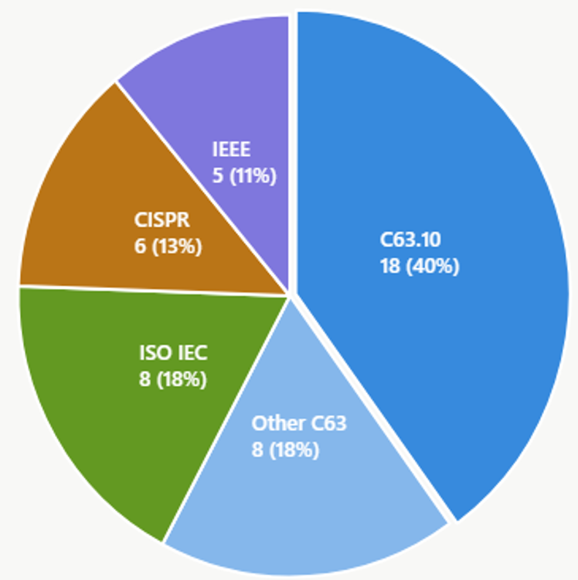
Features of the New KDB Pub. 231607 on Standards (III)
All Technical Standards referenced in KDB publications have been categorizes in the new KDB Publication 231607, showing their function (e.g., “Site Validation”, “Laboratory and TCB Recognition’, etc.):
  Incorporated by reference with relevant Rule parts (presently, 14 Standards)
  Not incorporated by reference but applicable as cited (presently, 10 Standards)
  FCC-published measurement methods (e.g., MP-5)
Example. KDB Pubs. that reference Standards incorporated by reference.

Slide 8
What Standard Committees Can Do for the FCC Mission (I)
Coordination, coordination, coordination…
Regulators do not intend to control consensus-based Standards Committee activities however…
…coordination is vital: certainly, one wants to avoid that a Standard and an NRPM (Notice of Proposed Rulemaking) are pointing in different directions.
That may generate confusion in the industry; industry ultimately cares about a smooth sailing towards equipment authorization.
For example, some early coordination efforts along these lines have been pursued by the OET Lab. for the area of Wireless Power Transfer: the main point was to stress the need of focusing on leakage field limits, not device power.

Slide 9
What Standard Committees Can Do for the FCC Mission (II)
For example, some early coordination efforts along these lines have been pursued by the OET Lab. for Wireless Power Transfer (WPT) devices.
As discussed in KDB 680106, the focus of compliance is based on leakage field strength; the actual nominal power of the device is not a key parameter.
In general, from both EMC and RF exposure perspectives, the end-use of the transferred energy to the receiver is not a compliance concern: for instance, an induction cooker hob or an EV charger are treated the same way.
Thus, ultimately a WPT is treated just like any other radio, the only difference may be in Part 18 allowances when using ISM frequencies (for a given energy, all photons “look” the same, regardless of their end-use).

Slide 10
What Standard Committees Can Do for the FCC Mission (III)
Industry is facing a rapidly increasing number of required compliance test cases, due larger design complexity and integration of multiple transmitters operating simultaneously in the same device.
In most market-relevant cases, the impact/cost of RF exposure testing is dwarfing that for EMC.
There is a need of identifying “safe” (i.e., compliance–conservative) test reduction avenues, e.g., devising analysis-based (not statistical) scenarios that can be considered as a representative “worst-case”.
Another marginally developed test area is that of real-time power control to ensure time-average RF exposure compliance (some ongoing work at OET lab ).

Slide 11
Conclusions
Effort for integrating Technical Standards content in OET Lab. guidance for equipment is being supported by a new KDB Publication.
Coordination efforts with the FCC are highly encouraged before pouring efforts in a new Standard development of revision.
Compliance test-reduction procedures based on rigorous engineering analysis may be one of the industry’s most sought-for and impactful near-term objective.

