Slide 1
C63 SC3 International
American National Standards
Committee C63 - EMC
Ernesto Mendoza
October 2024

Slide 2
Subcommittee 3 (SC3) is responsible for promoting and facilitating harmonization of C63 publications with those developed by national and international standards bodies. SC3 establishes and maintains liaisons with these standards bodies or the appropriate national committee to facilitate coordination and cooperation. SC3 is also responsible for writing and maintaining existing and proposed C63 standards as assigned by the Main Committee American National Standards Committee (ANSC) C63

Slide 3
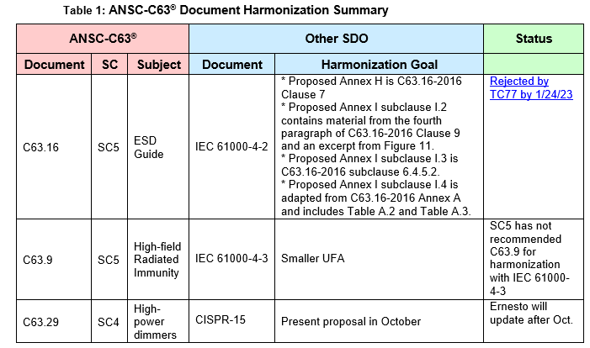

Slide 4
International Activates Review
American National Standards
Committee C63 - EMC
The following International Activates were discussed at the meeting
CISPR
CISPR D
CISPR I
CISPR H
CISPR H

Slide 5
American National Standards
Committee C63 - EMC
Next SC3 International it will be hold at the May 5 2025 bi anula meeting.
Questions
Comments

