Slide 1
Emission Measurements of an Artificial EUT in an Anechoic Chamber up to 40 GHz
Max Rosenthal, Jörg Petzold, Ralf Vick
Chair of Electromagnetic Compatibility Otto von Guericke University, Magdeburg
September 30, 2024
Emission Measurements of an Artificial EUT in an Anechoic Chamber up to 40 GHz

Slide 2
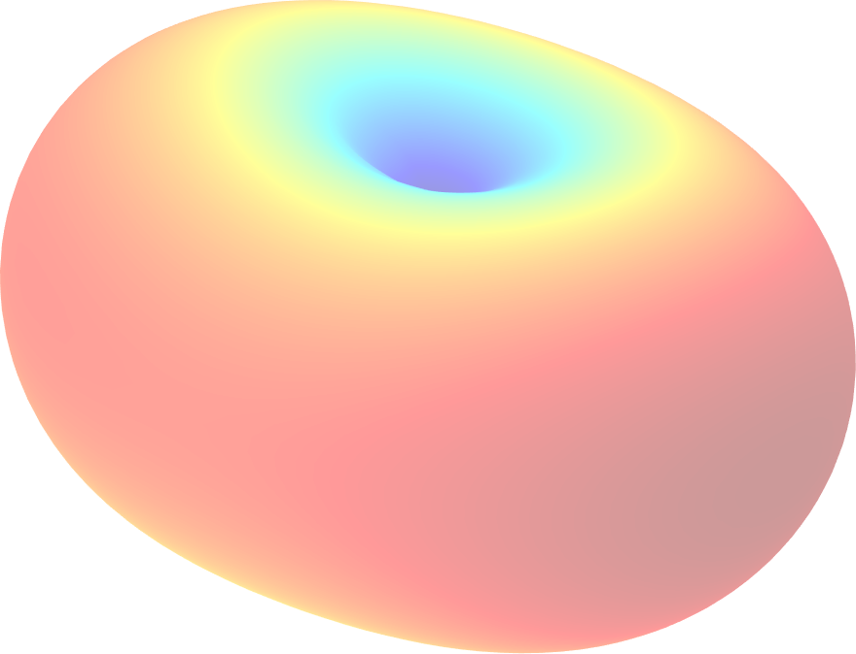
Artificial EUT
Setup & Procedure
Results & Validation
Conclusion & Outlook
Introduction
classic focus of EMC - protection of radio communication services
guaranteed by compliance with emission limits
verification in fully or semi-anechoic chambers
spatial sampling of the radiated electric field in the azimuth plane
z
y
EUT
φ
x
Emission Measurements of an Artificial EUT in an Anechoic Chamber up to 40 GHz
2

Slide 3
Artificial EUT
Setup & Procedure
Results & Validation
Conclusion & Outlook
Introduction
with 5G, some mobile services far above
1 GHz
existing normative procedures were adopted for frequencies up to 40 GHz
more complex radiation patterns at higher frequencies
detecting the maximum becomes less likely
z
y
EUT
φ
x
Emission Measurements of an Artificial EUT in an Anechoic Chamber up to 40 GHz
3

Slide 4
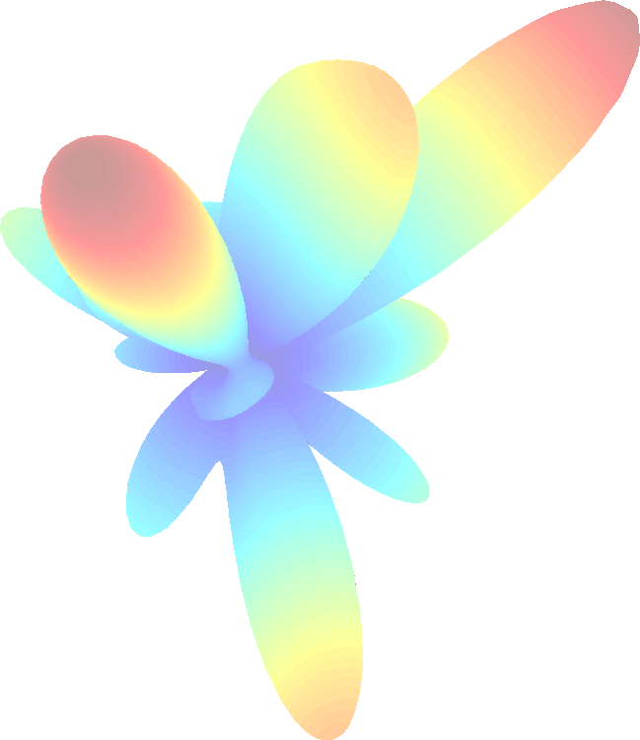
Artificial EUT
Setup & Procedure
Results & Validation
Conclusion & Outlook
Introduction
with 5G, some mobile services far above
1 GHz
existing normative procedures were adopted for frequencies up to 40 GHz
more complex radiation patterns at higher frequencies
detecting the maximum becomes less likely
z
y
EUT
φ
x
Emission Measurements of an Artificial EUT in an Anechoic Chamber up to 40 GHz
3

Slide 5
Artificial EUT
Setup & Procedure
Results & Validation
Conclusion & Outlook
Introduction
with 5G, some mobile services far above
1 GHz
existing normative procedures were adopted for frequencies up to 40 GHz
more complex radiation patterns at higher frequencies
detecting the maximum becomes less likely
z
y
EUT
φ
x
Are the normative methods still suitable?
Emission Measurements of an Artificial EUT in an Anechoic Chamber up to 40 GHz
3

Slide 6


Artificial EUT
Setup & Procedure
Results & Validation
Conclusion & Outlook
Stochastic model of a physical unintentional radiator
z
small, randomly, oriented and distributed dipole sources
sphere enclosing EUT
superposition of far fields
polarisation effects represented
ˆ
θ
⃗n
y
⃗r′
⃗n^{ˆ}⃗r′
i
i
φ
x
J. Petzold, et. al. "Monte Carlo Simulation of a Physical Random Unintentional Radiator as a Basis for Statistics in Fully Anechoic Room Measurements," 2023 International Symposium on Electromagnetic Compatibility – EMC Europe, Krakow, Poland, 2023, pp. 1-6
Emission Measurements of an Artificial EUT in an Anechoic Chamber up to 40 GHz

Slide 7
Artificial EUT
Setup & Procedure
Results & Validation
Conclusion & Outlook
Outline
Artificial EUT
Setup & Procedure Results & Validation Conclusion & Outlook
Emission Measurements of an Artificial EUT in an Anechoic Chamber up to 40 GHz

Slide 8
Artificial EUT
Setup & Procedure
Results & Validation
Conclusion & Outlook
Artificial EUT
Emission Measurements of an Artificial EUT in an Anechoic Chamber up to 40 GHz

Slide 9

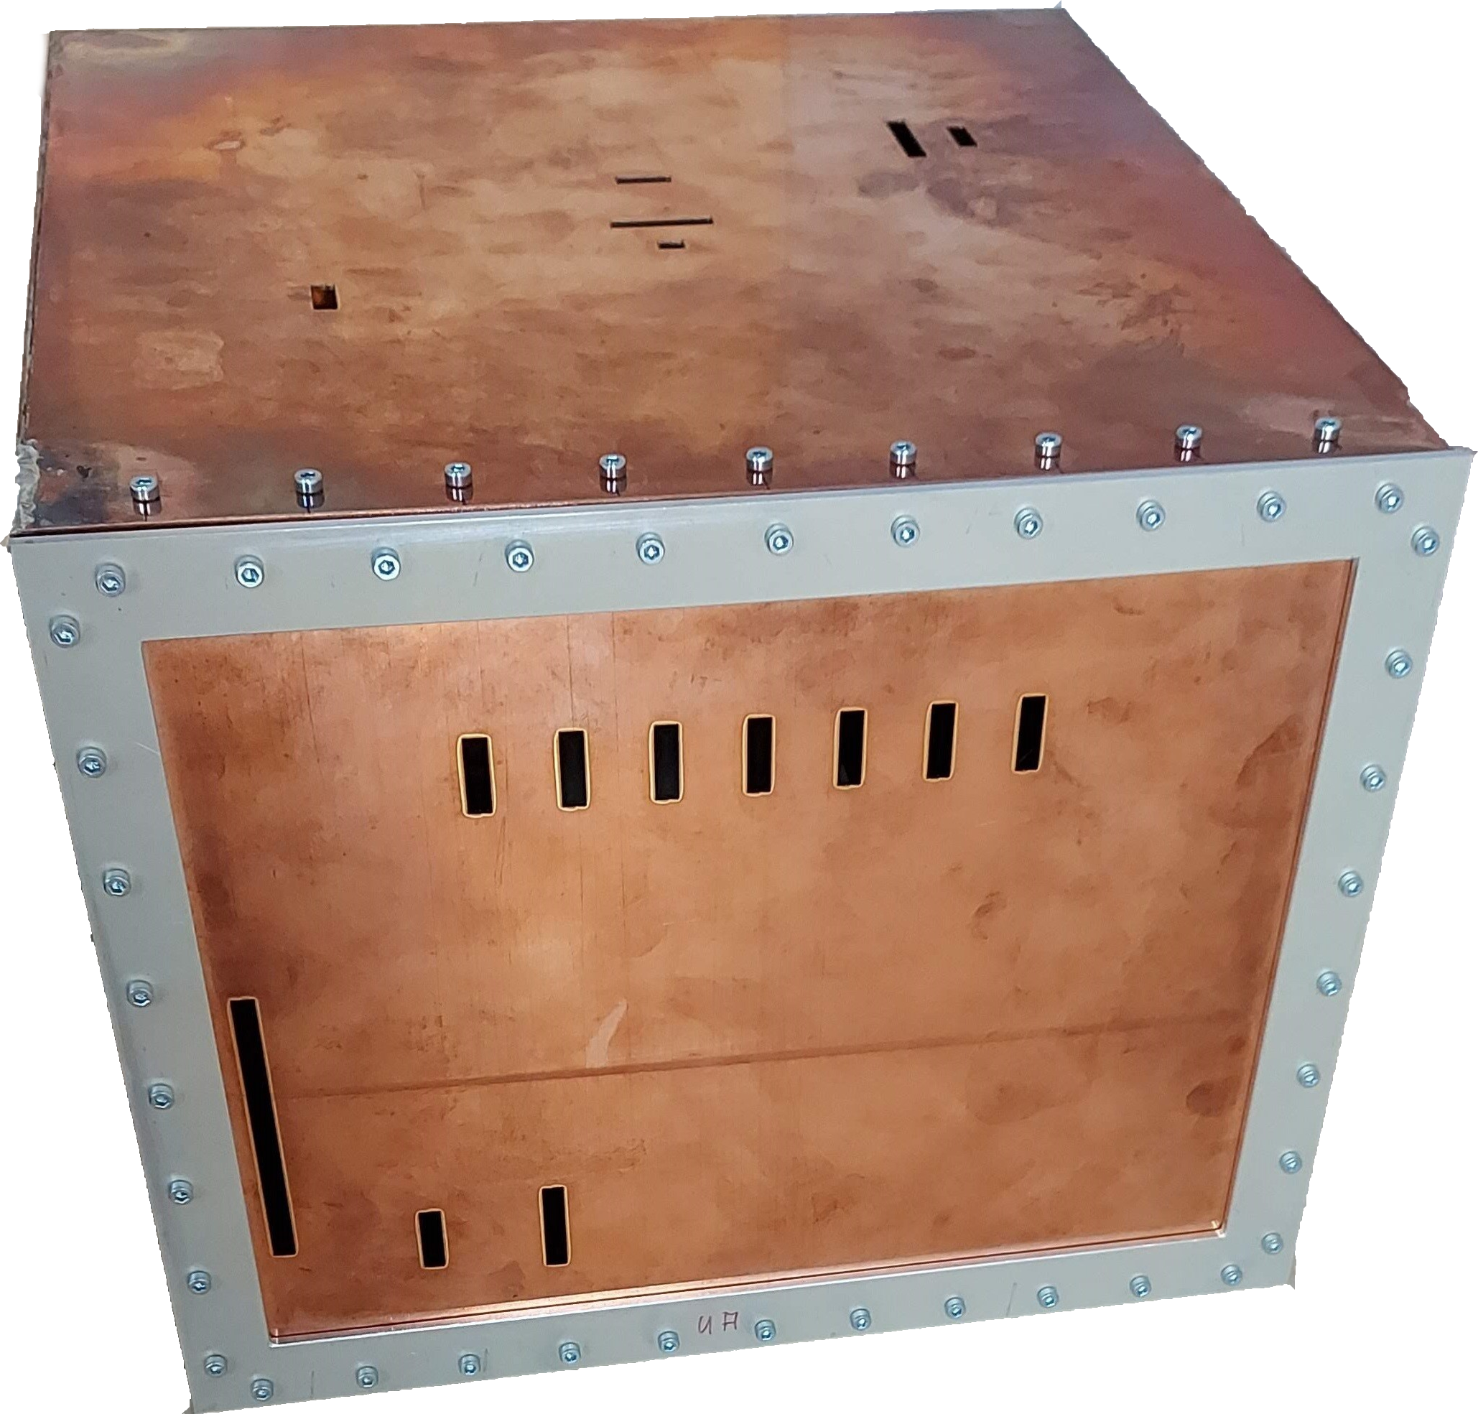
Artificial EUT
Setup & Procedure
Results & Validation
Conclusion & Outlook
Artificial EUT (Front View)
310 × 290 × 230 mm (W × H × D)
arbitrarily distributed and oriented slots
longest slot 75 mm, f_{r} = 2 GHz
shortest slot 6 mm, f_{r} = 25 GHz
Emission Measurements of an Artificial EUT in an Anechoic Chamber up to 40 GHz
7

Slide 10
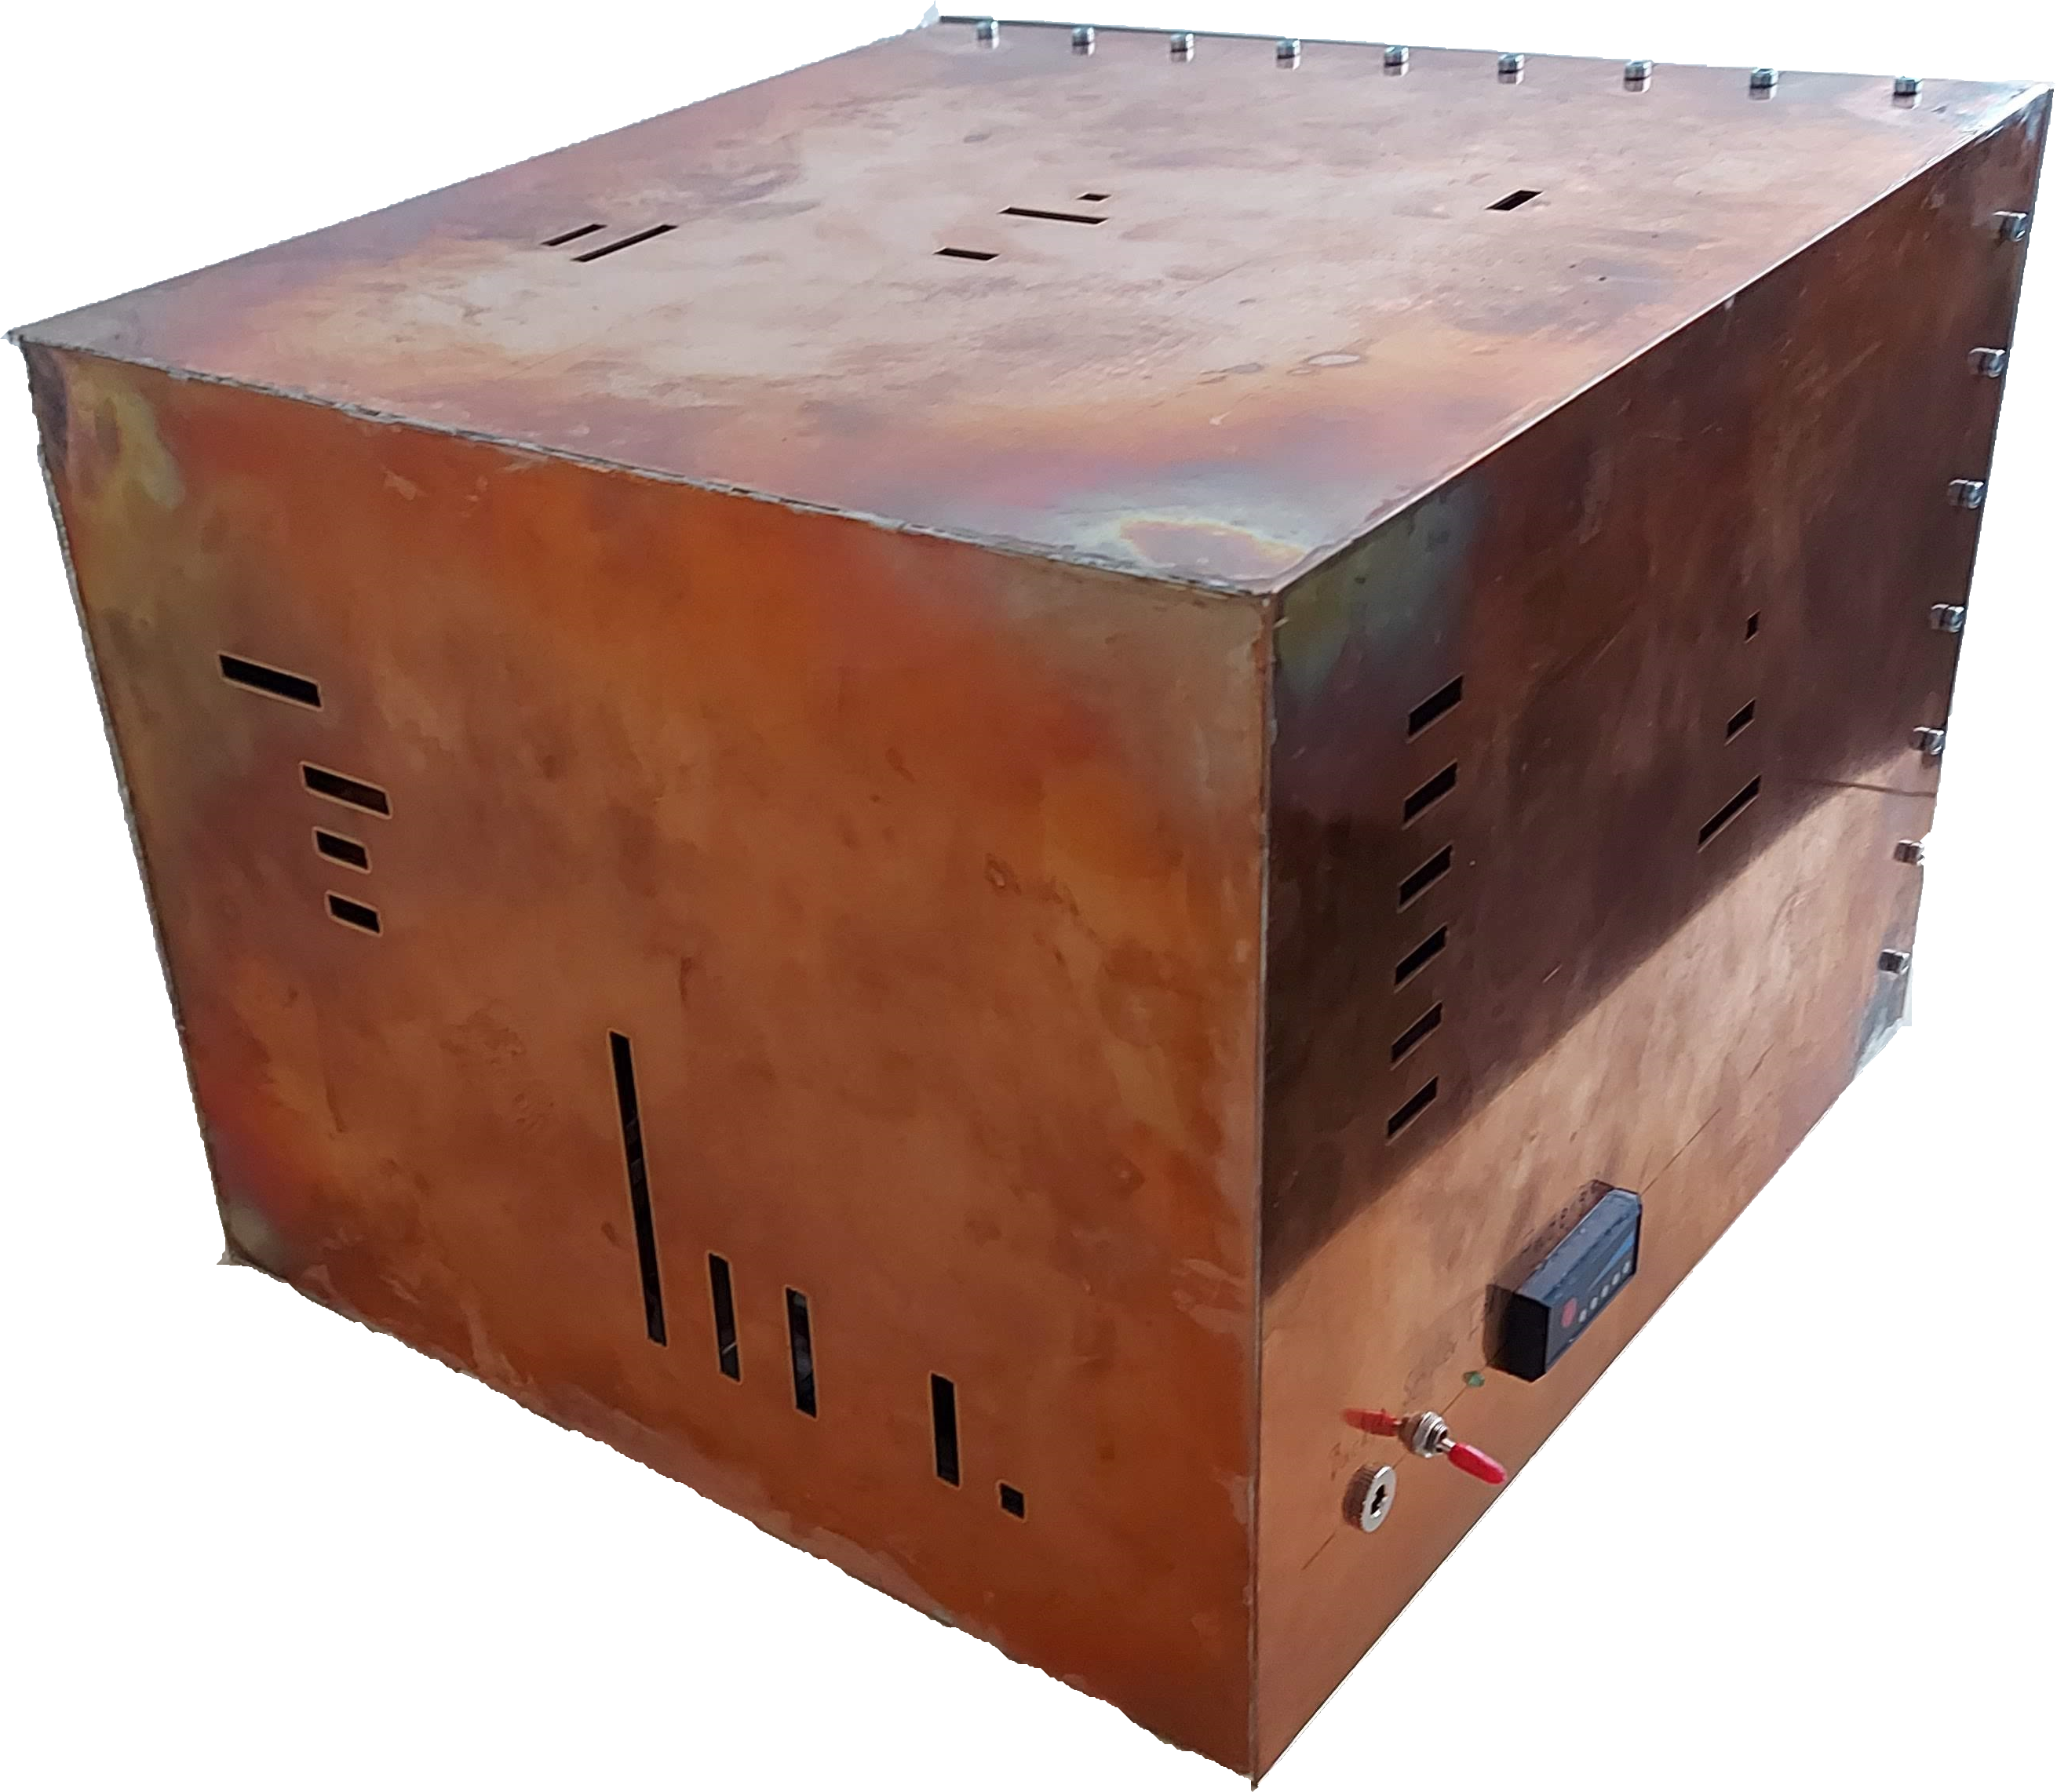
Artificial EUT
Setup & Procedure
Results & Validation
Conclusion & Outlook
Artificial EUT (Back View)
310 × 290 × 230 mm (W × H × D)
arbitrarily distributed and oriented slots
longest slot 75 mm, f_{r} = 2 GHz
shortest slot 6 mm, f_{r} = 25 GHz
Emission Measurements of an Artificial EUT in an Anechoic Chamber up to 40 GHz
7

Slide 11
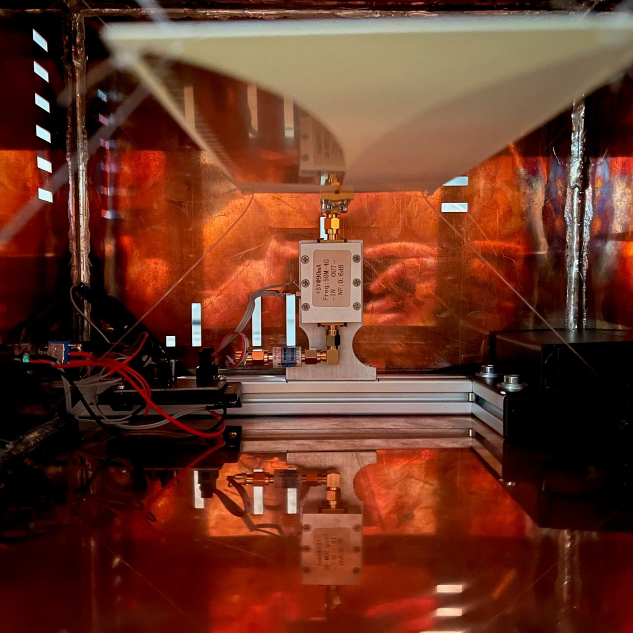
Artificial EUT
Setup & Procedure
Results & Validation
Conclusion & Outlook
Artificial EUT (Interior View)
1 GHz sine wave oscillator
amplifier
comb generator
broadband planar vivaldi antenna
battery powered
Emission Measurements of an Artificial EUT in an Anechoic Chamber up to 40 GHz

Slide 12
Artificial EUT
Setup & Procedure
Results & Validation
Conclusion & Outlook
Setup & Procedure
Emission Measurements of an Artificial EUT in an Anechoic Chamber up to 40 GHz

Slide 13
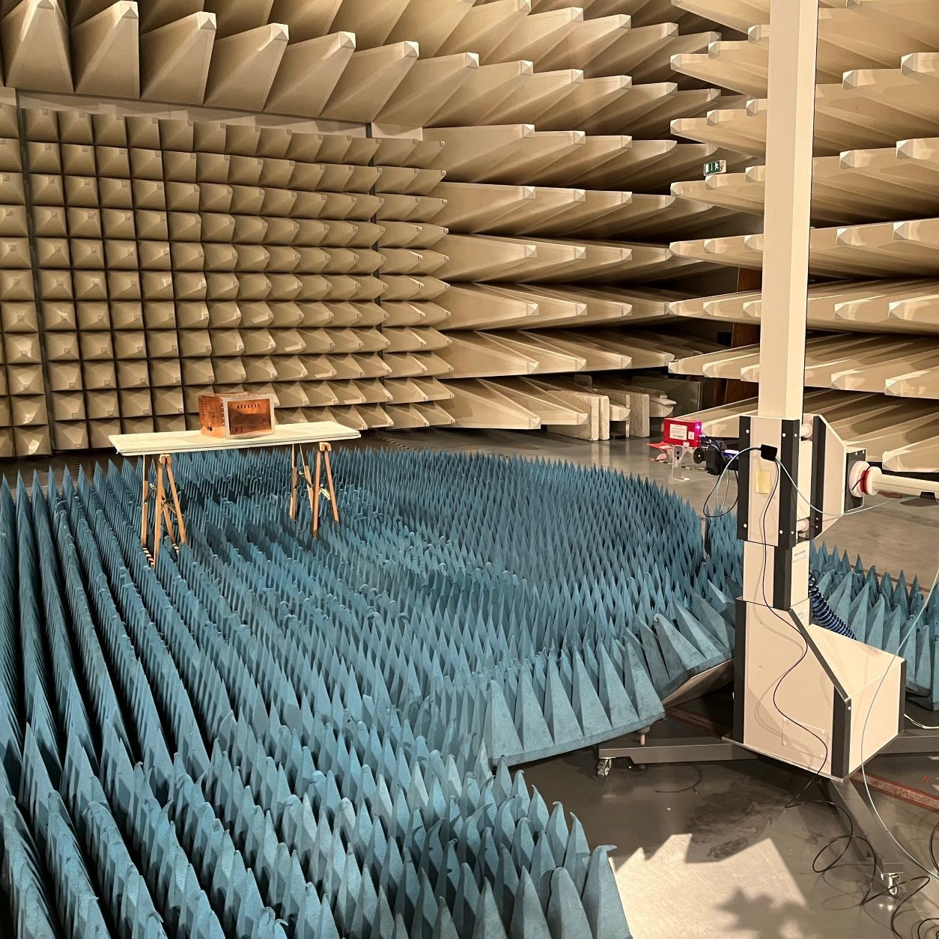
Artificial EUT
Setup & Procedure
Results & Validation
Conclusion & Outlook
Normative Procedure for Emissions Measurements
Standards
CISPR-16-2-3 (up to 18 GHz)
ANSI C63.4-2014 (up to 40 GHz)
General Procedure:
spatial sampling of the EUT
horizontal and vertical polarisation
ANSI: manually position antenna over surface of EUT
Emission Measurements of an Artificial EUT in an Anechoic Chamber up to 40 GHz
10

Slide 14
Artificial EUT
Setup & Procedure
Results & Validation
Conclusion & Outlook
Normative Procedure for Emissions Measurements
Standards
CISPR-16-2-3 (up to 18 GHz)
ANSI C63.4-2014 (up to 40 GHz)
Setup:
absorber-lined semi-anechoic chamber
non-conductive table
turntable and antenna mast
Emission Measurements of an Artificial EUT in an Anechoic Chamber up to 40 GHz
10

Slide 15
Artificial EUT
Setup & Procedure
Results & Validation
Conclusion & Outlook
Normative Procedure: Measurement Distance
prefered measurement distance 3 m
Emission Measurements of an Artificial EUT in an Anechoic Chamber up to 40 GHz
11

Slide 16
Artificial EUT
Setup & Procedure
Results & Validation
Conclusion & Outlook
Normative Procedure: Measurement Distance
80
70
60
E in dB_{µV/m}
prefered measurement distance 3 m
ambient noise 6 dB below limit
50
40
30
Peak Avg
FCC-6 dB FCC-6 dB
20
20
f in GHz
10
30
40
Emission Measurements of an Artificial EUT in an Anechoic Chamber up to 40 GHz
11

Slide 17
Artificial EUT
Setup & Procedure
Results & Validation
Conclusion & Outlook
Normative Procedure: Measurement Distance
10
D=0.3 m D=0.15 m
8
D=0.1 m
R_{ff} = 3 m
prefered measurement distance 3 m
ambient noise 6 dB below limit
2
R_{ff} in m
6
4
far field distance R ≈
2D
λ
2
ff
0
20
f in GHz
10
30
40
Emission Measurements of an Artificial EUT in an Anechoic Chamber up to 40 GHz
11

Slide 18
Artificial EUT
Setup & Procedure
Results & Validation
Conclusion & Outlook
Normative Procedure: Spatial Sampling
full rotation in azimuth 0◦ to 360◦
CISPR: ∆ϕ_{min} = 15◦
ANSI: ∆ϕ_{min} = 22.5◦
step size used: ∆ϕ = 1◦
Emission Measurements of an Artificial EUT in an Anechoic Chamber up to 40 GHz

Slide 19
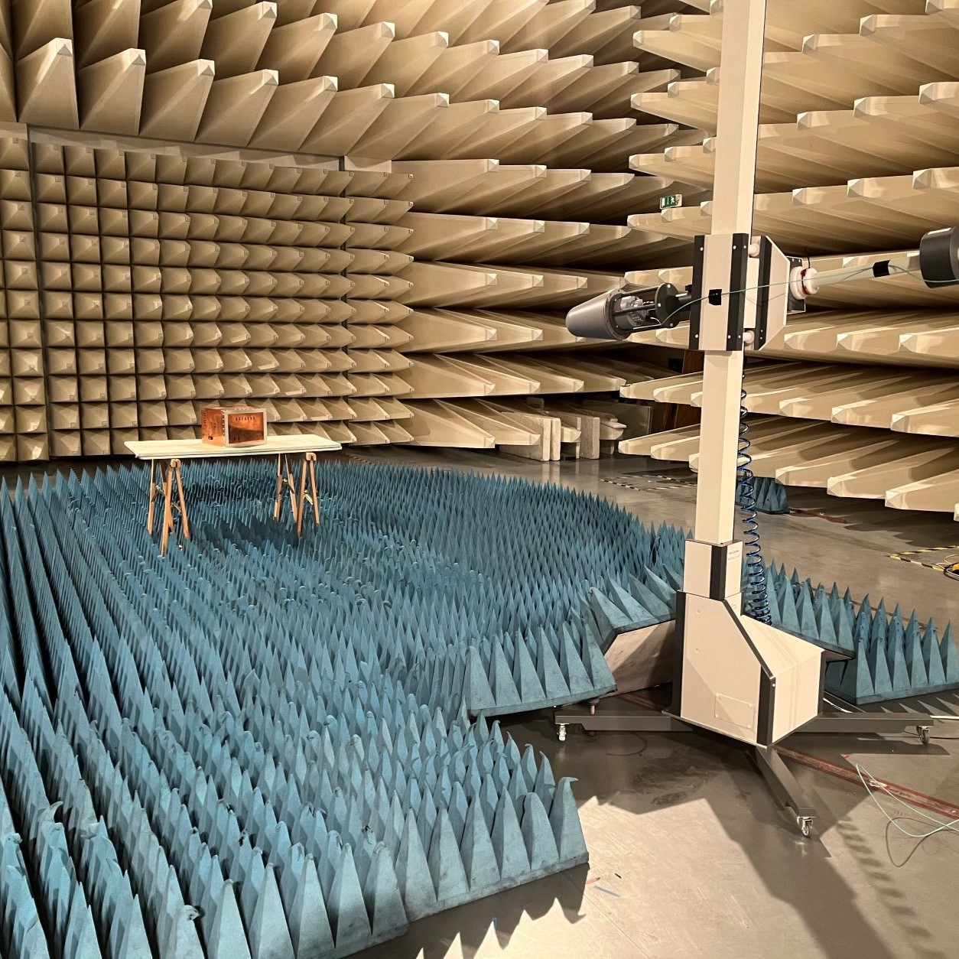
Artificial EUT
Setup & Procedure
Results & Validation
Conclusion & Outlook
Normative Procedure: Height Scan
if beamwidth of antenna smaller than vertical dimension
1 m to 4 m (no antenna alignment)
step size used: ∆ϕ = 1◦
Emission Measurements of an Artificial EUT in an Anechoic Chamber up to 40 GHz

Slide 20
Artificial EUT
Setup & Procedure
Results & Validation
Conclusion & Outlook
Results & Validation
Emission Measurements of an Artificial EUT in an Anechoic Chamber up to 40 GHz

Slide 21
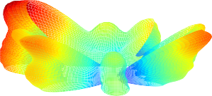

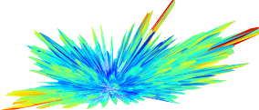
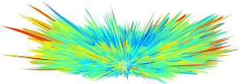
Artificial EUT
Setup & Procedure
Results & Validation
Conclusion & Outlook
Radiation Patterns
lower frequencies, few wide beams
higher frequencies, many narrow beams
maximum not in azimuth
insufficient to determine direction of maximum at one frequency
despite complexity, many local maxima of same magnitude
f = 1 GHz, ka = 5, 23
f = 6 GHz, ka = 31, 41
f = 18 GHz, ka = 94, 24
f = 40 GHz, ka = 209, 43
Emission Measurements of an Artificial EUT in an Anechoic Chamber up to 40 GHz

Slide 22
Artificial EUT
Setup & Procedure
Results & Validation
Conclusion & Outlook
Maximum electric field strength
Real detected maximum:
E_{real} = max{E_{h}(φ, ϑ), E_{v}(φ, ϑ)}
φ,ϑ
f = 1 GHz, ka = 5, 23
f = 6 GHz, ka = 31, 41
f = 18 GHz, ka = 94, 24
f = 40 GHz, ka = 209, 43
Emission Measurements of an Artificial EUT in an Anechoic Chamber up to 40 GHz
16

Slide 23


Artificial EUT
Setup & Procedure
Results & Validation
Conclusion & Outlook
Maximum electric field strength
Real detected maximum:
z
E_{real} = max{E_{h}(φ, ϑ), E_{v}(φ, ϑ)}
φ,ϑ
Detected maximum by standard:
E_{sta} = max{E_{h}(φ, 0◦), E_{v}(φ, 0◦)}
φ
y
x
Emission Measurements of an Artificial EUT in an Anechoic Chamber up to 40 GHz
16

Slide 24
Artificial EUT
Setup & Procedure
Results & Validation
Conclusion & Outlook
Maximum electric field strength
Real detected maximum:
z
E_{real} = max{E_{h}(φ, ϑ), E_{v}(φ, ϑ)}
φ,ϑ
Detected maximum by standard:
E_{sta} = max{E_{h}(φ, 0◦), E_{v}(φ, 0◦)}
φ
y
x
Emission Measurements of an Artificial EUT in an Anechoic Chamber up to 40 GHz
16

Slide 25
Artificial EUT
Setup & Procedure
Results & Validation
Conclusion & Outlook
Maximum electric field strength
Real detected maximum:
z
E_{real} = max{E_{h}(φ, ϑ), E_{v}(φ, ϑ)}
φ,ϑ
Detected maximum by standard:
E_{sta} = max{E_{h}(φ, 0◦), E_{v}(φ, 0◦)}
φ
y
x
Emission Measurements of an Artificial EUT in an Anechoic Chamber up to 40 GHz
16

Slide 26
Artificial EUT
Setup & Procedure
Results & Validation
Conclusion & Outlook
Maximum electric field strength
Real detected maximum:
z
E_{real} = max{E_{h}(φ, ϑ), E_{v}(φ, ϑ)}
φ,ϑ
Detected maximum by standard:
E_{sta} = max{E_{h}(φ, 0◦), E_{v}(φ, 0◦)}
φ
y
x
Emission Measurements of an Artificial EUT in an Anechoic Chamber up to 40 GHz
16

Slide 27
Artificial EUT
Setup & Procedure
Results & Validation
Conclusion & Outlook
Maximum electric field strength
Real detected maximum:
z
E_{real} = max{E_{h}(φ, ϑ), E_{v}(φ, ϑ)}
φ,ϑ
Detected maximum by standard:
E_{sta} = max{E_{h}(φ, 0◦), E_{v}(φ, 0◦)}
φ
y
x
Emission Measurements of an Artificial EUT in an Anechoic Chamber up to 40 GHz
16

Slide 28
Artificial EUT
Setup & Procedure
Results & Validation
Conclusion & Outlook
Maximum electric field strength
Real detected maximum:
z
E_{real} = max{E_{h}(φ, ϑ), E_{v}(φ, ϑ)}
φ,ϑ
Detected maximum by standard:
E_{sta} = max{E_{h}(φ, 0◦), E_{v}(φ, 0◦)}
φ
y
x
Emission Measurements of an Artificial EUT in an Anechoic Chamber up to 40 GHz
16

Slide 29
Artificial EUT
Setup & Procedure
Results & Validation
Conclusion & Outlook
Maximum electric field strength
Real detected maximum:
z
E_{real} = max{E_{h}(φ, ϑ), E_{v}(φ, ϑ)}
φ,ϑ
Detected maximum by standard:
E_{sta} = max{E_{h}(φ, 0◦), E_{v}(φ, 0◦)}
φ
y
Relative level difference:
( )
E
sta
∆L = 20 log
10
Ereal
x
Emission Measurements of an Artificial EUT in an Anechoic Chamber up to 40 GHz
16

Slide 30
Artificial EUT
Setup & Procedure
Results & Validation
Conclusion & Outlook
Influence of the spatial sampling (without height scan)
0
−2
−4
−6
−8
−10
∆Lmax in dB
∆ϕ_{s} ↑, ∆L_{max} ↑
f ↑, ∆L_{max} ↑
high f, ∆L_{max} = const.
∆φs = 5◦
∆φs = 10◦
∆φs = 15◦
∆φ = 30◦
s
−12 ₁
3
6
10
40
f in GHz
Emission Measurements of an Artificial EUT in an Anechoic Chamber up to 40 GHz

Slide 31
Artificial EUT
Setup & Procedure
Results & Validation
Conclusion & Outlook
Influence of the spatial sampling (with aligned height scan)
0
−2
−4
−6
−8
−10
∆Lmax in dB
∆φs = 5◦
improvement 2 dB to 4 dB
∆φs = 10◦
∆φs = 15◦
∆φ = 30◦
s
−12 ₁
3
6
10
40
f in GHz
Emission Measurements of an Artificial EUT in an Anechoic Chamber up to 40 GHz

Slide 32
Artificial EUT
Setup & Procedure
Results & Validation
Conclusion & Outlook
Comparison fixed and aligned height scan
f = 1 GHz
f = 6 GHz
80
75
V in dB_{µV}
70
tilted
fix
∆L in dB
0
−2
V
fix
−4
Vtilt
100
150
200
h in cm
250
300 100
150
200
h in cm
250
300
Emission Measurements of an Artificial EUT in an Anechoic Chamber up to 40 GHz
19

Slide 33
Artificial EUT
Setup & Procedure
Results & Validation
Conclusion & Outlook
Comparison fixed and aligned height scan
f = 18 GHz
f = 40 GHz
80
V in dB_{µV}
tilted
fix
60
40
0
−5
∆L in dB
Vfix Vtilt
−10
100
150
200
h in cm
250
300 100
150
200
h in cm
250
300
Emission Measurements of an Artificial EUT in an Anechoic Chamber up to 40 GHz
19

Slide 34
Artificial EUT
Setup & Procedure
Results & Validation
Conclusion & Outlook
Stochastic model of a physical unintentional radiator
z
50 dipole souces
radius a = 24 cm
replicate measurements by Monte Carlo simulation
1000 realisations
ˆ
θ
⃗n
y
⃗r′
⃗n^{ˆ}⃗r′
i
i
φ
x
J. Petzold, et. al. "Monte Carlo Simulation of a Physical Random Unintentional Radiator as a Basis for Statistics in Fully Anechoic Room Measurements," 2023 International Symposium on Electromagnetic Compatibility – EMC Europe, Krakow, Poland, 2023, pp. 1-6
Emission Measurements of an Artificial EUT in an Anechoic Chamber up to 40 GHz

Slide 35
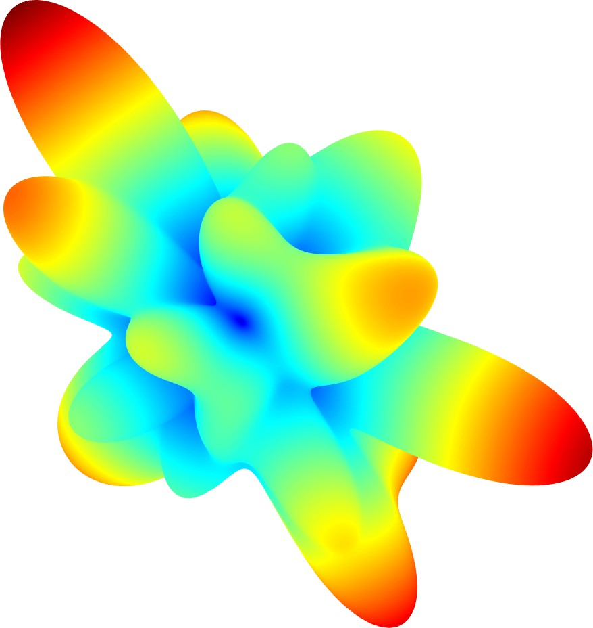
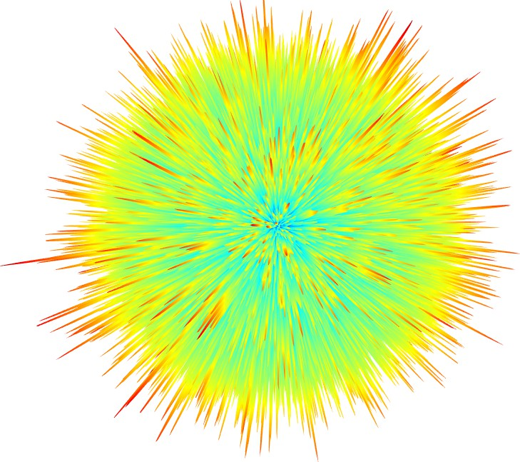
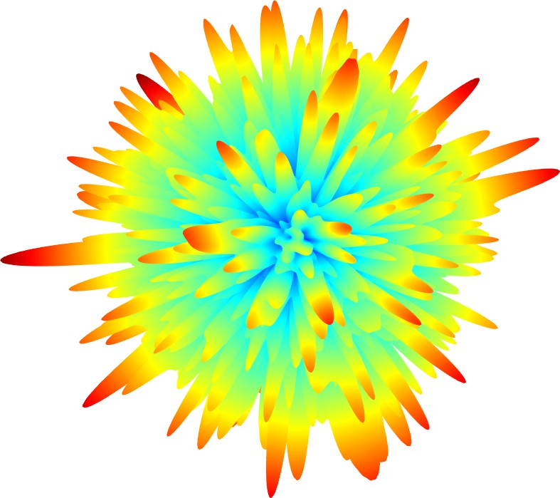
Artificial EUT
Setup & Procedure
Results & Validation
Conclusion & Outlook
Radiation Pattern EUT a = 24 cm
f = 1 GHz
f = 6 GHz
f = 40 GHz
0
0.2
0.4
0.6
0.8
1
^{E}/Emax
Emission Measurements of an Artificial EUT in an Anechoic Chamber up to 40 GHz

Slide 36
Artificial EUT
Setup & Procedure
Results & Validation
Conclusion & Outlook
Validation of the theoretical Model
∆φs = 5◦
∆φs = 10◦
Real detected maximum:
0.0
∆L˜ in dB
−2.5
−5.0
−7.5
−10.0
0.0
E_{real} = max{E_{h}(φ, ϑ), E_{v}(φ, ϑ)}
φ,ϑ
median
5-95 perc. EUT
Detected maximum by standard:
∆φs = 15◦
∆φs = 30◦
E = max{E (φ, 0◦), E (φ, 0◦)}
sta h v
φ
∆L˜ in dB
−2.5
−5.0
−7.5
Relative level difference:
( )
E
sta
∆L = 20 log
−10.0 ₁
3 6 10
f in GHz
40 1
3 6 10
f in GHz
40
10
Ereal
Emission Measurements of an Artificial EUT in an Anechoic Chamber up to 40 GHz

Slide 37
Artificial EUT
Setup & Procedure
Results & Validation
Conclusion & Outlook
Conclusion & Outlook
Emission Measurements of an Artificial EUT in an Anechoic Chamber up to 40 GHz

Slide 38
Artificial EUT
Setup & Procedure
Results & Validation
Conclusion & Outlook
Conclusion
Summary
Normative procedure is highly dependent on the angular resolution
For higher frequencies height scan without antenna alignment insufficient
Stochastic radiator model represents the deviations very well
Discussion
Normative procedure not suitable in terms of accuracy and reproducibility
Definition of a frequency-dependent angular resolution
Definition of a frequency and angular dependent uncertainty
Alternative procedure in the mode-stirred chamber according to IEC-61000-4-21
Emission Measurements of an Artificial EUT in an Anechoic Chamber up to 40 GHz
24

Slide 39
To b or not to b?
Additional Comments by Zhong Chen
Counter Point #1: Because of the ground plane reflection, boresight is not necessarily better.
A scientific study is to isolate parameters. The systematic study shows that there is clearly a significant difference between boresighted and non-boresighted scan (with other influence removed). Ground plane reflection must be addressed by its own root cause. Using antenna pattern to address another deficiency is uncontrolled, antenna dependent, and compounds with another error source, resulting in unbounded measurement uncertainties.
Boresighting method removes antenna dependency with bounded uncertainties. Free-space results is approx. ½ of those for scanned over ground.
Two wrongs do not make a right!

Slide 40
To b or not to b?
2. Based on literature search, all published studies have made similar conclusions, for example, from CISPR/A/741 (2007), Dr. K. Sieczkarek (2017, 2022), from Dr. Battermann (2024) and Dr. M. Rosenthal (published in 09/24). They all concluded that a linear scan underestimates emissions. I could not find any published study which supports the current C63 study and results.
3. The study from Rosenthal is part of a broader systematic study, validated against a theoretical/statistical model, representing a typical EUT well.

Slide 41
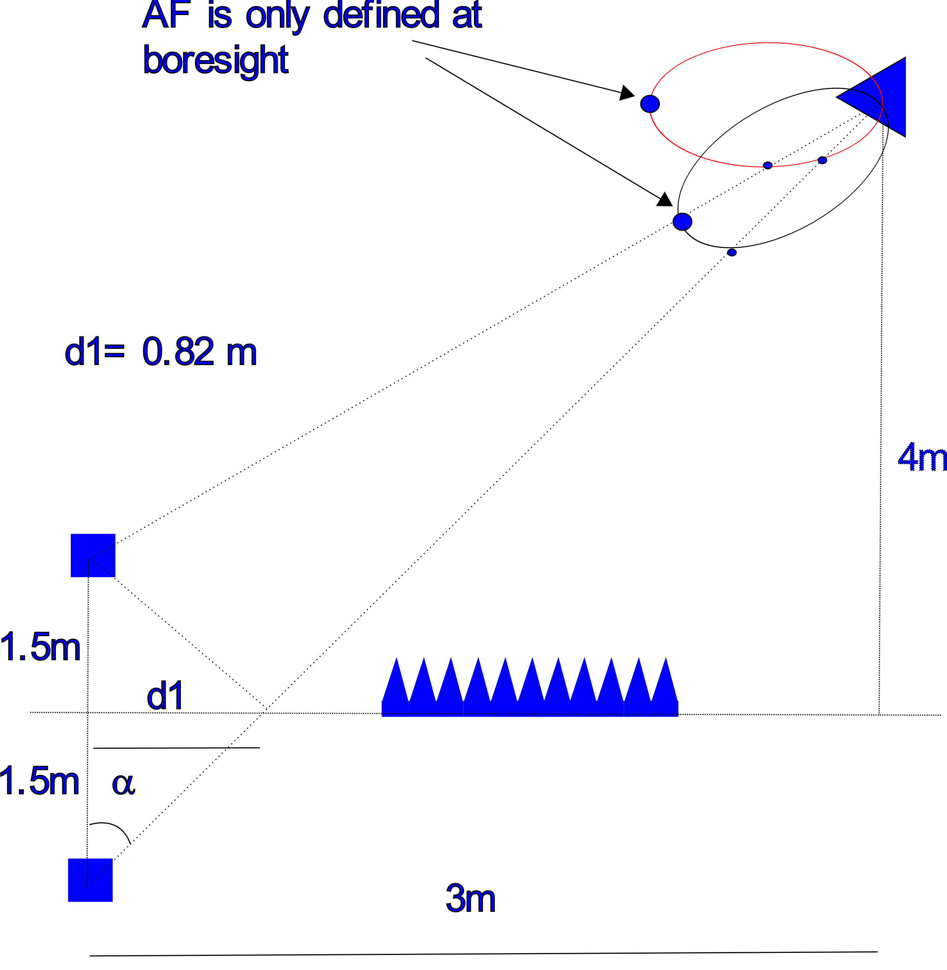
To b or not to b?
Ground plane could possibly be seen, but relying on uncontrolled sidelobe of an antenna to reduce the reading is not a tenable position.
Possible solution: half the reading of boresight scanned data.

Slide 42
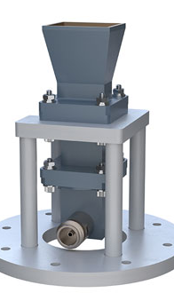
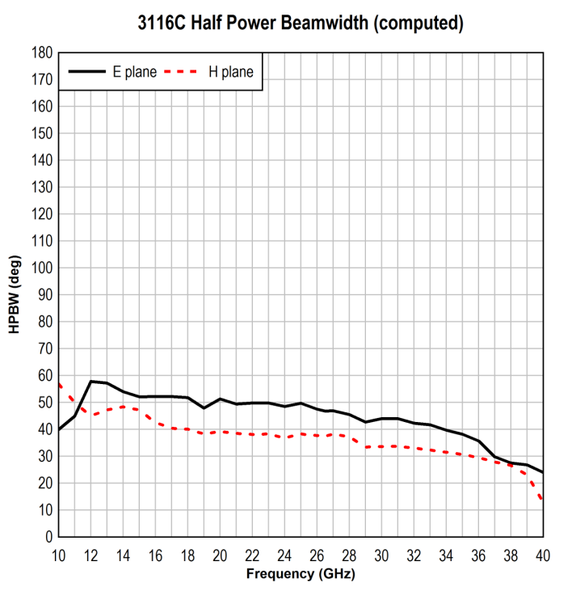
26.5 – 40 GHz.
A 10 dBi horn has a HPBW of ~55 deg
A 20 dBi horn has a HPBW ~18 deg

