Slide 1
American National Standards Committee C63® - EMC
Chairman’s Report
Bob DeLisi
Chair – C63 Committee
October 4, 2024

Slide 2
American National Standards Committee C63® - EMC
Thank you for Hosting

Slide 3
American National Standards Committee C63® - EMC
Standards Update since May meetings
ANSI Approved/Published
C63.10:2020 Amendment 1
C63.25.2:2024
C63.14:2024

Slide 4
American National Standards Committee C63® - EMC
2024 Meetings
Hybrid meetings held for Subcommittees –
Main Committee was hybrid in the spring and Face-to-Face only in the fall.
Working group meetings continued virtually on an as-needed basis.
2025 Meetings
Hybrid meetings will be held for Subcommittees and the Main Committee will be face-to-face.
Working group meetings to continue virtually on an as-needed basis.

Slide 5
American National Standards Committee C63® - EMC
C63 Operating Procedures
Procedures submitted to IEEE Secretariat (J. Santulli). Awaiting feedback from IEEE and ANSI on updated procedure content.

Slide 6
American National Standards Committee C63® - EMC
FCC/ISED Updates -
C63.30 –
KDB 680106 - D01 Wireless Power Transfer v04
When applicable, for all the testing required to show compliance of WPT systems, adherence to the ANSI C63.30-2021 (American National Standard for Methods of Measurement of Radio-Frequency Emissions from Wireless Power Transfer Equipment) is encouraged.
RSS-216 issue 3
Now calls directly to C63.30. Annex A has some normative deviations cited.
C63 has petitioned FCC to adopt C63.25.2
C63 is in the process of petitioning FCC to adopt C63.10-Cor1-2023 and C63.10a-2024

Slide 7
American National Standards Committee C63® - EMC
FCC Updates -
Bob, Andy and Nick, met via Teams, with FCC staff on August 16th to discuss FCC/C63 related items. Main takeaway is FCC indicated that petitions for adoption of C63 standards into FCC rules should include information on how compliance with the rules is achieved by the standards petitioned. FCC is also looking at potential ways of including C63 standards in methods allowed before petitions are completed (e.g. via KDB reference, like C63.30).
Bob, Nick, and Mac met via Teams with FCC on September 26 to discuss the matter of antenna tilting to ensure that if C63 standards make changes we are not going against any internal FCC requirements for unintentional vs intentional radiator testing. FCC would like to see information to support changing current practices and was informed that this type of information will be an informative annex in at least one of our standards, likely C63.4, which can then be referenced by other C63 standards if/when updated.

Slide 8
American National Standards Committee C63® - EMC
Financial Information
Membership Dues – 2025 invoices to be sent in January 2025 unless special arrangements have been made to get invoices earlier.
Membership cost – there will be a minor increase in 2025
Organizational member - $4000.00
Individual member - $1400.00
Last increase was in 2018
If any company needs to be invoiced in 2024 for 2025, let Brenda know.
Organization is doing well financially

Slide 9
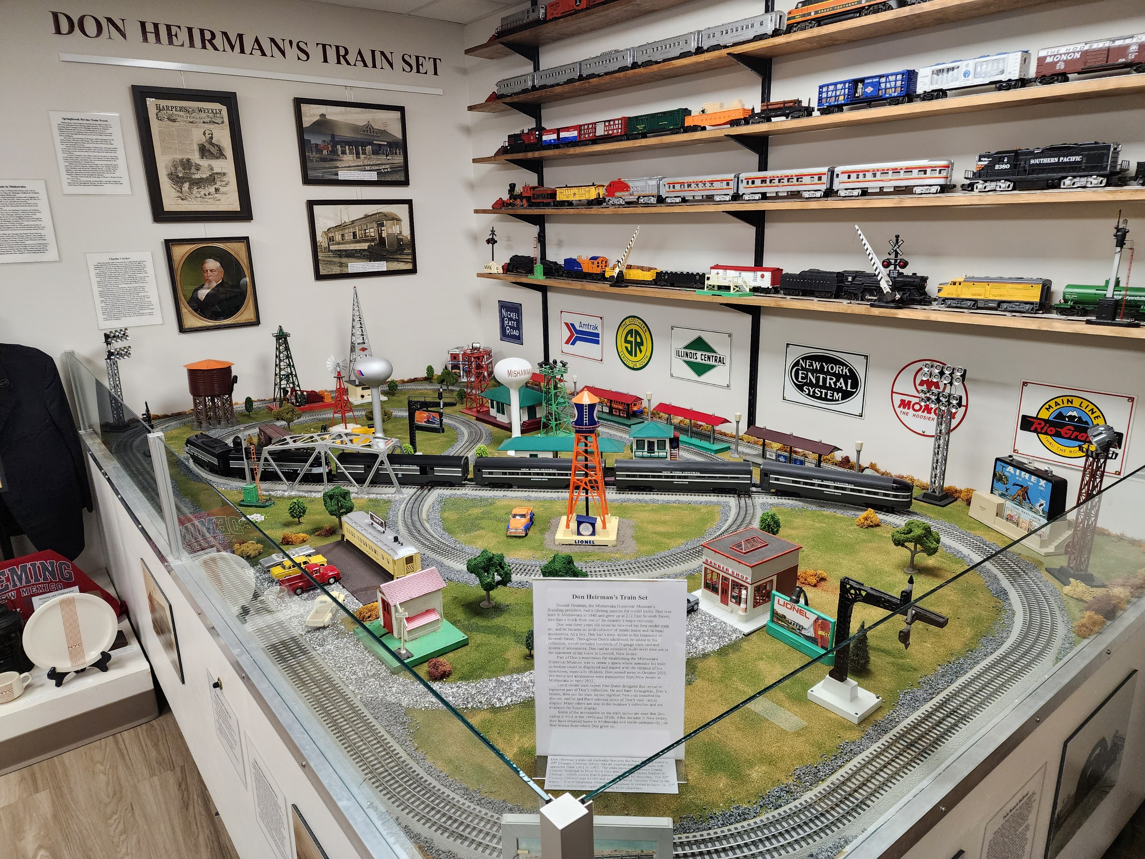
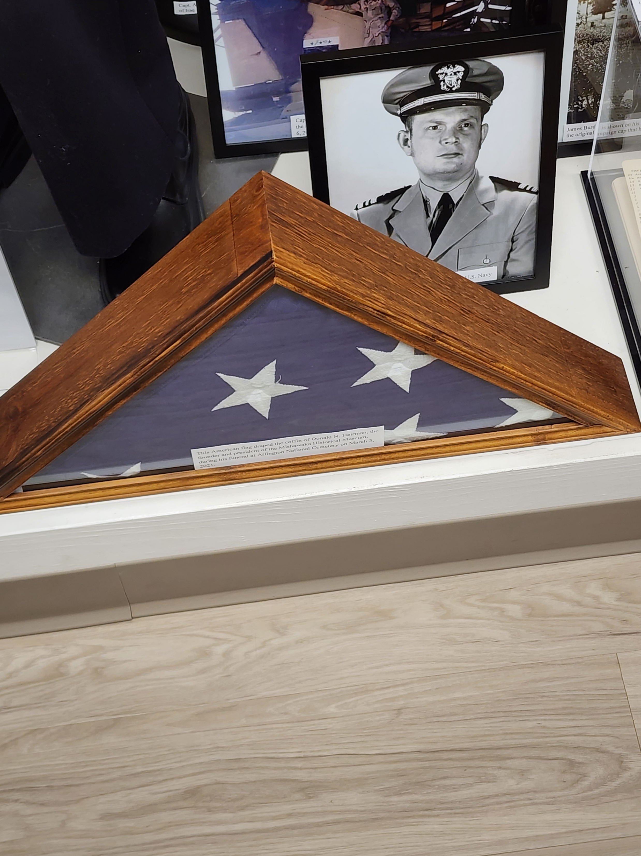
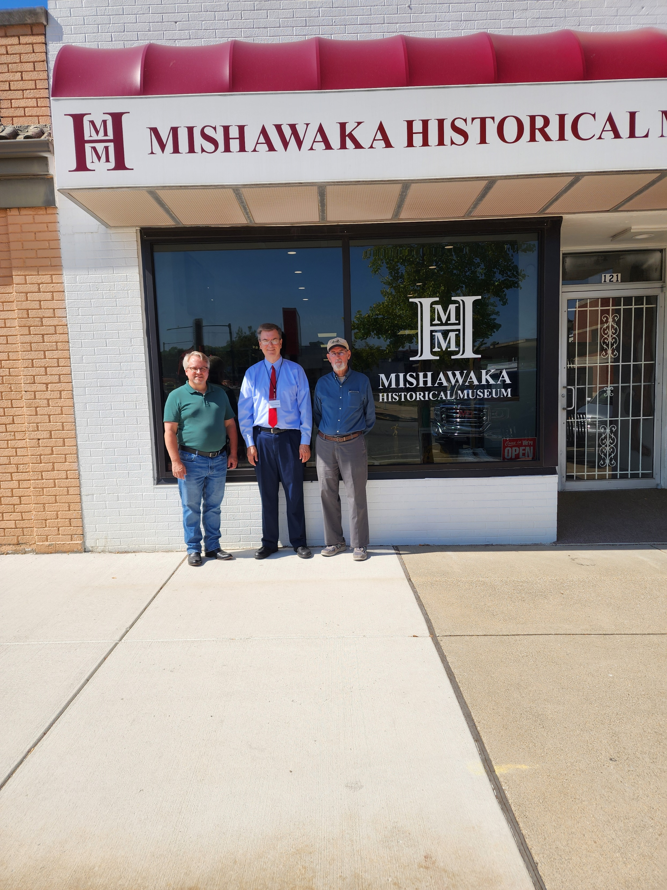
American National Standards Committee C63® - EMC
Courtesy of Art Wall

Slide 10
American National Standards Committee C63® - EMC
Questions?

