Slide 1
Accredited Standards Committee C63® - EMC
SC6 Accreditation / Conformity Assessment
Doug Kramer
SC6 Chair
October 4, 2024

Slide 2
Accredited Standards Committee C63® - EMC
Working Group Reports
Liaison Reports
AB Reports
Review of Action Items

Slide 3
Accredited Standards Committee C63® - EMC
Scope
The scope was reviewed, and no changes were proposed.
Subcommittee 6 is responsible for providing a resource for laboratory assessment activities. It works on many aspects related to laboratories, regulators and accreditation bodies. Representatives of the accreditation bodies, laboratories, and regulators are invited to give a report on the status of EMC testing and calibration activities.

Slide 4
Accredited Standards Committee C63® - EMC
Duties
WG3 to draft a guide for Inter-lab comparison of EMC testing - Suspended
WG4 to draft a guide Calibration of EMC Test Equipment.

Slide 5
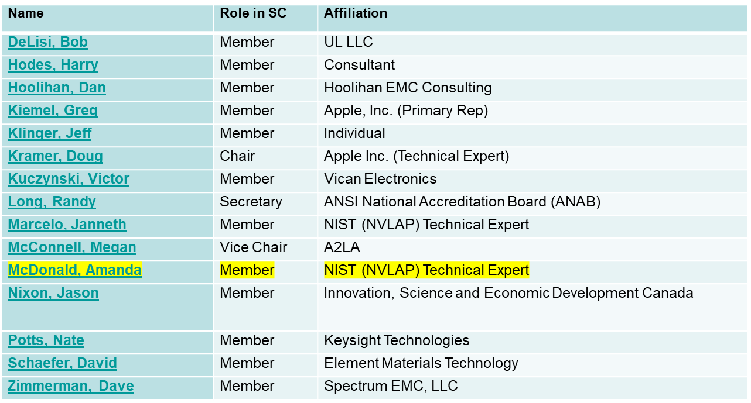
Accredited Standards Committee C63® - EMC
Membership Report (changes highlighted)

Slide 6
Accredited Standards Committee C63® - EMC
Motions
SC6 chair moves to approve the membership of subcommittee 6.

Slide 7
Accredited Standards Committee C63® - EMC
Working Group Reports
The WG chair of C63.34 will send the document to the SC for review and comment.
C63.11 (suspended) Harry Hodes is developing a new PINS to restart this effort with a focus on Inter- and Intra- laboratory comparisons rather than Proficiency Testing.

Slide 8
Accredited Standards Committee C63® - EMC
External Reports
A2LA - presentation received
ANAB - presentation received
NVLAP - presentation received
ACIL/ACE-PT - presentation on the state of the program and measurements
Presentations are attached to the meeting minutes and available in the SC6 members area

Slide 9
Accredited Standards Committee C63® - EMC
Comments/Concerns from Stakeholders
CABs – none received
FCC – none received
ISED – Jason Nixon provided a verbal report and answered some question brought up in AB presentations
FDA – none received
TCBC – none received

Slide 10
Accredited Standards Committee C63® - EMC
Action Item Summary
Action Item # | Subject | Responsible Person | Status | Deliverable Date | Comments
202310-02 | ABs to formulate a method to gain assessor feedback on nonconformities appearing to be related to confusing or unclear language in standards so the information related to C63 standards can be brought to SC6 for dissemination to other Subcommittees. | Megan M. | Open
202310-03 | SC6 chair to relay to SC1 to review wording around LISN usage and calibration due to AB feedback. | Doug K. | Open
202405-02 | Investigate how many CABs SCC accredits to our standards in consideration of inviting them to participate | Doug K. | Open

